Slide 1

Fear Not: Trust Accounting Basics
Tom Gorowsky
Max Weyforth

Slide 3

Trust Accounting at its Core
Used to hold the funds of your clients to be used or earned in the future
They safeguard the property of your clients
They keep your funds separate from your clients
Used exclusively as the client directs
To protect against the misuse of client funds
When in doubt, refer to Rule 1.15 & MN Appendix 1
Trust
Accounting
Notes:
Think of trust funds like we used to think of social distancing – maybe we will call it financial distancing…
Also Used for 3rd party funds – anything not the property of the attorney
Other types of trust accounts 1. individual client account, 2. pooled account (calc own interest), 3. IOLTA (primary, what we will focus on) - all nominal / short period funds are required to be in IOLTA in MN
Rule 1.15, MRPC, governs a lawyer’s obligations for maintaining, accounting for and distributing client or third party funds in the lawyer’s possession. Appendix 1 sets forth a lawyer’s recordkeeping obligations for funds held in trust.
<a href="https://www.flaticon.com/free-icons/legal-services" title="legal services icons">Legal services icons created by Uniconlabs - Flaticon</a>

Slide 4


What Goes into Your Trust Account
Trust Account | Attorney’s Operating Account
Advanced Deposits for Client costs | Earned Fees
Unearned Retainers | Compliant Flat Fee retainers
Settlement proceeds
Third-party Funds
Anything held by the Attorney on behalf of their client that is unearned at the time of receipt
Notes:
Third party funds include funds subject to doctors’ liens, disputed funds, and court-ordered deposits.
Flat fees and payments for services already rendered do not need to go in unless included with other unearned funds. If earned funds go in, they should be immediately moved.
Can only place Flat Fee retainers in the operating account if you have a signed agreement that complies with Rule 1.5(b)(1). Flat fee retainers if you have a compliant signed fee agreement may be treated as the lawyer’s property subject to refund.
Think about trust account funds as the assets in the account belong to the client or third parties. They are not owned by the lawyer, and once they are, they should be removed.
How do you ensure you didn’t exclude anything from your trust account?
When in doubt, it’s best practice to use your trust account. If you haven’t earned the funds, they should be in the trust.

Slide 5

IOLTA Trust Accounts
Interest on Lawyer Trust Accounts
For nominal and short-term holdings of client funds
Interest on the account is automatically calculated and transferred to the State IOLTA Program each month
Benefits for All
Attorneys: No interest tracking necessary
Clients: Secure and safe funds
Everyone: Legal Aid Programs
Notes:
Joke about RAS Syndrome (redundant acronym syndrome) for IOLTA Trust Accounts
These are the focus of our conversation and the most common type of trust account.
IOLTA Accounts are used for clients / matters that are only contributing small amounts of $, so individually, no interest there is virtually no interest generated. However, pooled with other client accounts the interest generated is more substantial in total.
Also can be used for funds held for a short amount of time as the interest generation is also nominal.
IOLTA is should be used in Minnesota for nominal / short term amounts held. Almost all Banks support the IOLTA program. There is a list of these institutions available on the Board site.
The banks participating in this program do track your accounts and have the responsibility to report overdrafts to the Director’s office.
Minnesota IOLTA Legal Aid programs provide civil legal aid to the poor and support improvements to the justice system. All states and some territories have an IOLTA program contributing to similar programming.
There is a situation where you may have to track interest if the IOLTA interest transfer is not completed within the month earned. Use of an approved financial institution should alleviate that need.

Slide 6
Flow of Trust Accounting Transactions
Payment to yourself for earned fees
Receipt of funds from your client
Deposit ALL funds into Trust Account
Payment to others for legal expenses, transaction fees, etc.
Refund to your client for unused funds
Notes:
This represents the TYPICAL flow of transactions for trust accounting monies
There can be other nuances, but overall, most interactions would look similar to this chart.
For instance, funds may be from a settlement or third party rather than directly from a client. If those funds end up in the trust, then ensure they have been cleared before remitting to the client or paying yourself on fees.
All of these steps include some sort of Trust accounting task such as recording the transactions in the books and records and notifying the client.
Funds may be received from your client via check, ACH, CC, or even cash.
Funds should ALL be deposited into the trust account, even if a portion of those funds are already earned. The earned portion should be immediately transferred out of the trust once the checks / transactions clear.
Flat fee arrangements/retainers do not need to be deposited into the trust, only receipts which some / all of the amount is yet to be earned
In Q&A we discuss the nuance for CC deposits – You should deposit CC payments into your operating account then immediately transfer the unearned portion to the trust
Why? To protect against the banks ability to reverse CC charges from trust and avoid CC fees charged on the transaction so the burden to pay those is on the attorney, not the client / trust.
Once fees in the trust are earned, they should be moved from the trust account immediately and placed in the attorney operating account.
In practice, it can be helpful to not make too many transactions in your trust account to lower the risk of mistakes, so recording of earned fees at the end of each month is reasonable.
Funds in the trust can also be used to pay for legal expenses other than the lawyers fees. These could include really anything but some examples are transaction fees, filing fees, expert fees (like us), etc.
Finally, once a matter is resolved, if there are unspent funds, they should be remitted back to the client.

Slide 7

Don’t Dread, Just Use Your Head to Protect Their Bread: Core Trust Accounting Requirements
Notes:
Trust accounting includes many rules and regulations that must be followed to avoid penalties, fines, investigations, and other things. However, there are plenty of resources that are available to dive deep into each and every rule.
For this CLE, we are going to focus on the big topics that are the centerpiece of trust accounting – the basics that keep your trust accounting together, in-line, and compliant.
These topics are maintaining your books and records and completing your monthly reconciliations. We are about to talk about these, but making sure these two topics are in order are a huge step in being compliant with all trust accounting rules.
And remember, the most important thing of all is exercising care over your clients funds.

Slide 8
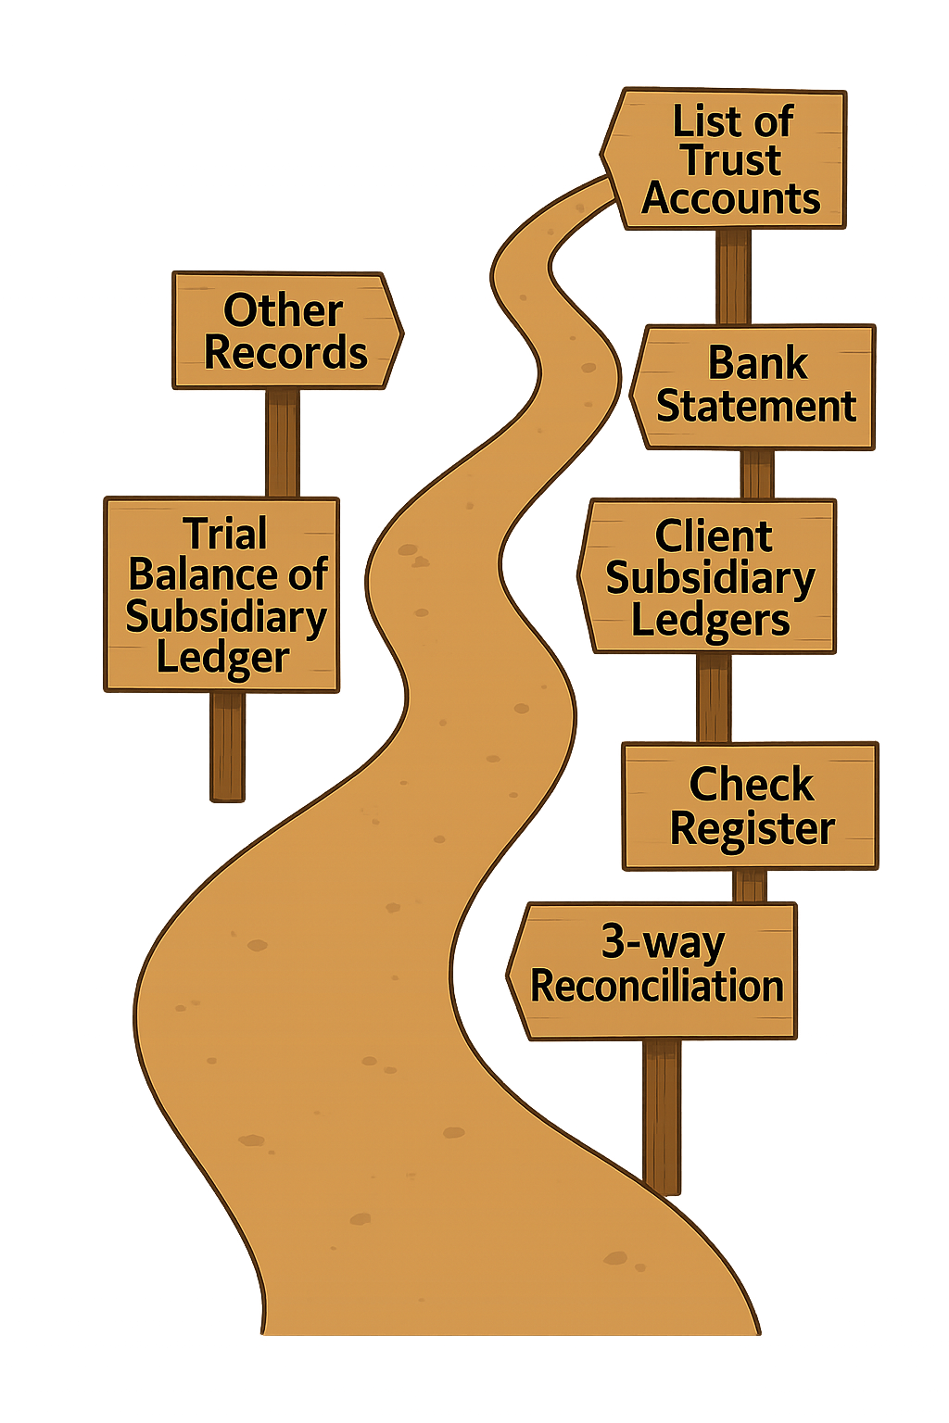

Maintaining a Paper Trail
Notes:
Remember these aren’t overwhelming, 1) use the IOLTA, 2) use an accounting software, and 3) keep track of your supporting docs.
In trust accounting, record keeping is a vital process for multiple reasons:
First, it is the best way to maintain a system for tracking your client funds, deposits, expenses and other transactions related to your trust account.
This can be a reference for you to look back at client accounts and ensure transparency for your clients when communicating about their balances.
Second, clean and diligent records mean in case of discrepancies in your accounts you should be able to easily identify the problem area, and if reconciliations are performed monthly, no issues should extend beyond the preceding 30 days.
Third, in the worst case scenario, you have organized records to provide the Directors Office in case of an investigation.
And, while it may take some time to set up organized records depending on your current record keeping status, once you have a system in place, updates can be efficient and effective.
Using software like QB, Smokeball, Etc. will do all of this for you as long as you enter the correct information.
they will update / track almost automatically.
You can summarize reports in different ways and even run reconciliations.
Banks also usually produce these records automatically which you can refer back to – however make sure you are aware of their retention policies in case you need to retain these yourself.
So what are Books and Records? These are the documents that need to be maintained to properly track your clients funds.
Records are documents created in the ordinary course of operating a bank account or handling other client property.
Books are the documents created to track client funds and transactions.
The ins (or inflows of funds) like retainer payments and settlement payments. And the Outs (or outflows of funds) like your earned fees for services, other legal fees, filing fees, and other expenses.
I know you all went to law school, and I can only presume it was solely to avoid anything to do with accounting. But as an accountant myself, I have to follow laws, so its only fair you have to do some accounting too.
To be discussed In the next slides, but these include:
List of all Trust Accounts Maintained (Records)
Check Register of all trust account transactions (Books)
Subsidiary Ledgers for each individual trust account (Books)
Monthly Books and Records
Trial Balance of Subsidiary ledgers (Books)
3 way Reconciliation (Books)
Other records (Records)
You should maintain business account records as well.

Slide 9
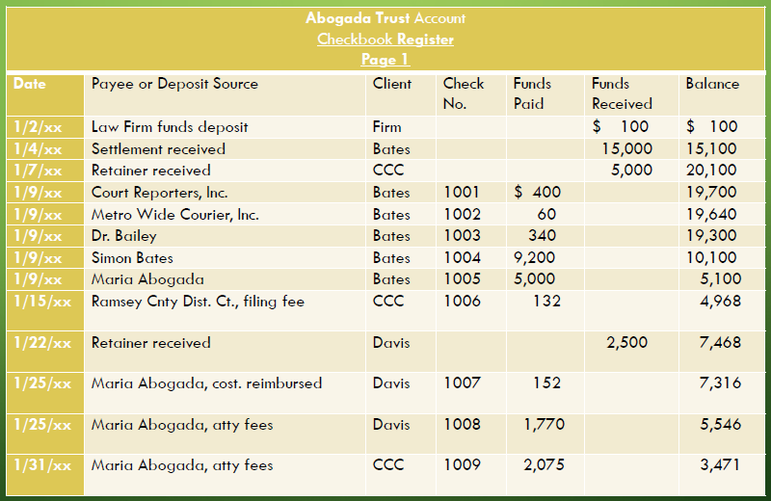
Books & Records: Check Register
Oldest
Newest
Notes:
Check Register of all trust account transactions (Books)
Transactions should include all relevant information such as dates/ client names, purpose, and any other relevant details in chronological order.
Maintain Records of your Check Register in PDF.
Most of these books and records can be easily created within an accounting software (insert some QB examples) and they will update / track almost automatically.
You can summarize reports in different ways and even run reconciliations.
Maintain books and records for 6 years (MN requirement) after the related legal issue is resolved for your client.

Slide 10
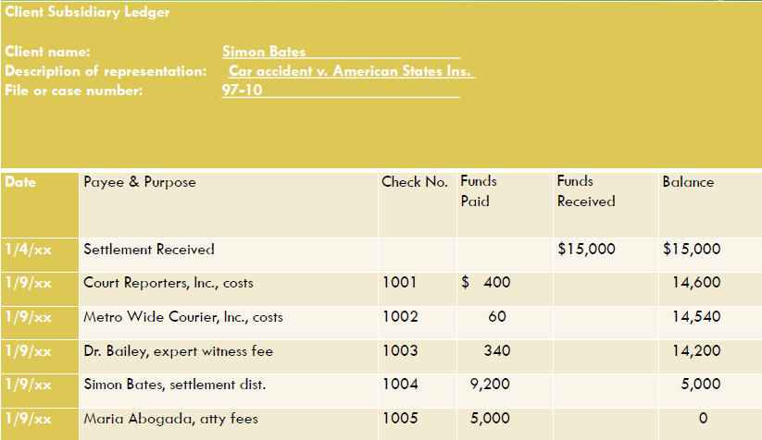
Books & Records: Client Subsidiary Ledger
Notes:
Subsidiary Ledgers for each individual trust account (Books)
Separated by client matter
Has the same information as the check register but separated by matter / client.
Also one for attorney funds (not exceeding $200)
Most of these books and records can be easily created within an accounting software (insert some QB examples) and they will update / track almost automatically.
You can summarize reports in different ways and even run reconciliations.
Maintain books and records for 6 years (MN requirement) after the related legal issue is resolved for your client.
Your client ledgers should NEVER be negative. This means you are overdrafting a client account and using funds they do not have.

Slide 11
Books & Records: Trial Balance of Subsidiary Ledgers
Notes:
Monthly Books and Records
Trial Balance of Subsidiary ledgers (Books)
Each client matter and their balances as of bank statement date
Maintain Records of your Trial Balance of subsidiary ledgers in PDF.
Most of these books and records can be easily created within an accounting software (insert some QB examples) and they will update / track almost automatically.
You can summarize reports in different ways and even run reconciliations.
Maintain books and records for 6 years (MN requirement) after the related legal issue is resolved for your client.
Your client ledgers should NEVER be negative. This means you are overdrafting a client account and using funds they do not have.

Slide 12

Other Records
Produced by your bank in the ordinary course
Check copies
Bank statements
Cancelled checks
Wire / ACH / Electronic transfer confirmations
Cash payment receipts
Notes:
Records are documents created in the ordinary course of operating a bank account or handling other client property.
Other records (Records)
Check copies
Bank statements
Cancelled checks
Wire / ACH / Electronic transfer confirmations (even electronic transfers require an authorization memo signed by the lawyer)
Documentation of cash payments (countersigned copy of a receipt signed by the payor)
Bank wire authorizations (signed by lawyer)
Deposit Slips (annotated with client name)
Banks also usually produce these records automatically which you can refer back to – however make sure you are aware of their retention policies in case you need to retain these yourself.
Remember that some auto records (like cash receipts and deposit slips) need to be annotated.
Maintain books and records for 6 years (MN requirement) after the related legal issue is resolved for your client.

Slide 13

Reconciliation
Bank Statement Balance
3-WAY MATCH
Trial Balance of Subsidiary Ledgers
Check Register
Notes:
Now reconciliations involve matching your books and records to each other.
This process takes your books and records and transforms them from separate pieces of chicken scratch (or a neatly organized database – but still separate) to an organized and RECONCILED collection of documents.
Yes, the reconciliations reconcile…or at least they should.
Reconciliations should be completed Monthly
This keeps your trust accounting current
Allows you to resolve issues quickly – within the month they occurred
In the event of investigation, you have updated reports.
3-way match of the Bank Statement, Trial Balance of Subsidiary Ledgers, and the Check Register.
Completed using transactions as of the date of the bank statement
All three should match. If they don’t you have to investigate!
Either you have an issue in your accounting, or more likely, there are outstanding checks which have been recorded in your ledgers but have not cleared the bank
Remember to maintain PDF copies of these documents and the reconciliation itself.
Does it make sense to use a recycling logo here? Absolutely, because this reconciliation process should be recycled every month.

Slide 14

Reduce the Errors & Alleviate your Terrors: A Trust Accounting Relationship from Beginning to End

Slide 15
Initial Deposit
Receipt of funds from your client in the form of an unearned retainer
Deposit the funds into your IOLTA Bank Account
Record the Transaction in the Client’s Subsidiary Ledger
Record the Transaction in your Check Register
Notes:
Receipt of funds from your client in the form of an unearned retainer
Deposit the funds into your IOLTA Bank Account
It must be your IOLTA Bank account as this is an IOLTA trust account relationship
Record the Transaction in the Client’s Subsidiary Ledger
If it’s a new client or a new matter, you'll have to create a new ledger
Record the Transaction in your Check Register
As you can see on the check register, there are transactions for other trust accounts, including the lawyers own funds. This is a collection of ALL transactions in the trust.
Often, if using a trust accounting software, the recording of the transaction in the check register and the subsidiary register can be done simultaneously.
In depth – but you would add the funds as a liability in your clients subsidiary ledger account. The you would note those same funds are deposited into your IOLTA bank account, tied to that client.
This is why documentation is so important, to make sure you know what each part of the transaction belongs to

Slide 16
Paying Attorney Fees and Client Expenses
Record the Transactions in the Client’s Subsidiary Ledger
Record the Transactions in the Check Register
Notes:
Transactions within the trust account can include attorneys earning their legal fees, expenses paid on behalf of the client for their legal needs, and ultimately a refund of unused funds back to the client.
Remember the Attorney CANNOT pay their own expenses out of the trust; they must first remove the funds, then pay them out of their operating account.
Once an attorney earns fees, they should remove the amount as soon as possible.
In the subsidiary ledger, transactions appear back-to-back.
In the check ledger that includes all transactions, the fees earned and refunds are mixed throughout other trust transactions.
The mixing of transactions is where problems can arise if you are not careful. But those can be resolved through reconciliations.

Slide 17
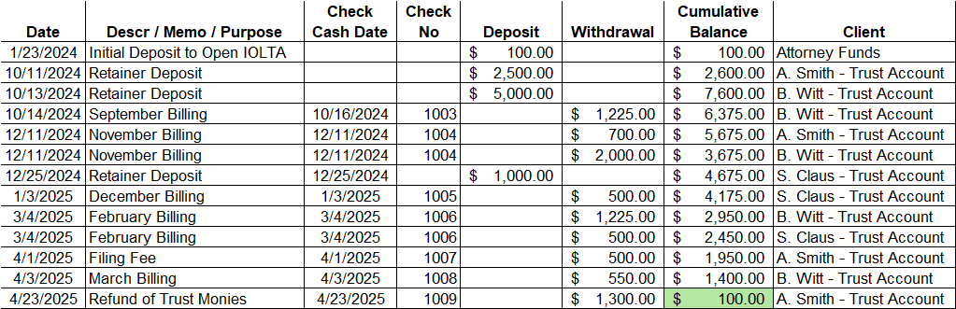
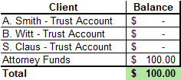
Reconciliations
Reconcile the Check Register…
To the Trial Balance of Subsidiary Ledgers.
Notes:
From the previous slide, we created the check register that includes all transactions in chronological order. This register is maintained throughout the trust accounting process and should typically be up to date in the normal course.
The Trial balance of subsidiary ledgers is not exactly created in the normal course. It is a conglomeration of ALL of the client subsidiary ledgers which ARE created and maintained in the normal course. Essentially, the trial balance of subsidiary ledgers, is all the separate client subsidiary ledgers combined into one document.
In most trust accounting software, these will always reconcile as when you enter a transaction, it will show up in both places.
IE in QuickBooks you would debit your IOLTA Bank account register (which would serve as the check register) and debit your client liability account which is their subsidiary ledger. All of your client liability accounts should equal the transactions in your IOLTA Bank account register.
Once your check register and trial balance of subsidiary ledgers match, you can move on to the bank statement reconciliation.
Note, you can do this exercise in any order, such as starting with your match of check register to the bank statement. They just have to all agree in the end.
Look at that! All your trust accounts are zeroed out at the end of this month, how very convenient

Slide 18
Reconciliations (cont.)
Reconcile the Trial Balance of Subsidiary Ledgers and Check Register to the Bank Statement.
Notes:
Since we already know the Check Register Matches the Trial balance of subsidiary ledgers, we can only look at the Check register for this part of the reconciliation
However, if unreconcilable differences are identified, then you may need to go back to the client subsidiary ledger or even other records!
In this reconciliation, originally our check register did not reconcile. But after reviewing the bank statement, we can see that the April refund check to A. Smith did not clear the bank yet.
If we adjust for outstanding checks, our balance reconciles and we are done.
From here, you will print (or PDF) your documents and save them in a safe place.
In the case the bank does not reconcile and you cannot figure it out through the use of outstanding checks, you may have to go back through all of your transactions to make sure
You did not miss any deposits or withdrawals made to your bank account
Transactions were recorded in the correct amounts
Transactions were recorded to the correct client accounts
Any other reason

Slide 19

Do it Right and Avoid a Fright: Issues, Errors, and Consequences

Slide 20
Real Trust Accounting Horrors
Using Trust Account for Personal Expenses
In re Edinger, 700 N.W.2d 462 (Minn. 2005)
In re Swaray, 867 N.W.2d 925 (Minn. 2015)
Failure to keep books and records
In re Reiter, 567 N.W.2d 699 (Minn. 1997)
Misappropriation: Distributing unearned client funds
re Eskola, 891 N.W.2d 294, 298-299 (Minn. 2017)
Notes:
In re Edinger, 700 N.W.2d 462 (Minn. 2005) – Overdrafts alerted the Director. He was using client funds for his own expenses and falsified transactions and documents in the amount of many thousands of dollars to cover it up.
Resulting in indefinite suspension, a fine, and right to apply for reinstatement after 4 months.
In re Swaray, 867 N.W.2d 925 (Minn. 2015) - Commingling funds, creating shortages in his trust account, issuing trust account checks in direct payment of his own personal and/or business expenses, and failing to maintain the required trust account books and records
Resulting in public reprimand and 2 years of supervised probation
In re Reiter, 567 N.W.2d 699 (Minn. 1997) – commingling funds, disbursing client funds from his trust account to clients prior to the deposit of funds on their behalf, failing to maintain proper trust account books and records, false certification to the supreme court that his books and records were properly maintained, failure to preserve his trust account books and records for the requisite period of time, and failing to arrange for the payment of interest to his trust account and the remittance of the interest to the Lawyers Trust Account Board.
Resulting in public reprimand and 2 years of supervised probation
re Eskola, 891 N.W.2d 294, 298-299 (Minn. 2017) - Consistently misappropriated funds by depositing unearned funds into the operating account, spending trust funds on personal expenses, and overdrafting clients. Even though he returned some of the funds eventually, it is still misappropriation.
Resulting in indefinite suspension with no right to petition for reinstatement for 18 months, a 2-year probationary period upon reinstatement, and a permanent prohibition on being an authorized signatory on a client trust account.

Slide 21
Common Issues & Errors
Comingling of Funds
Inaccurate and/or inconsistent record keeping
Not preparing monthly reconciliations
Failure to update clients about their accounts
Failure to move earned funds out of the IOLTA
Withdrawing funds before they clear the bank
Notes:
Comingling of Funds
Remember, you can keep SOME of your own funds in the account to pay for bank charges, check fees, and other transaction fees.
No / inaccurate / inconsistent record keeping
Can lead to issues in the reconciliation process and tracking client funds. Bad records can lead to most of the other issues listed.
No reconciliations
Reconciling the bank statement, check register, and client subsidiary ledger can resolve many issues that could otherwise lead to consequences. They should match each month.
Not updating your clients
Clients should be aware of what is happening to their money
Not moving earned funds out of the IOLTA
Can lead to comingling. Confusion on ownership of funds.
Withdrawing funds before they clear your bank and the issuing bank
Results in potential overdrawing a client account.
Overdrafts are reported to the Director’s office from the banks. Most of these are resolved without any disciplinary action.

Slide 22

Risks
Investigation
Fines/penalties
Public Reprimand
Suspension
Disbarment
Notes:
I suppose this is the fear in the “No fear” tagline of this presentation.
However, the basic topics we have covered in this CLE will help you avoid any headache…except maybe a headache you get from general accounting

Slide 23
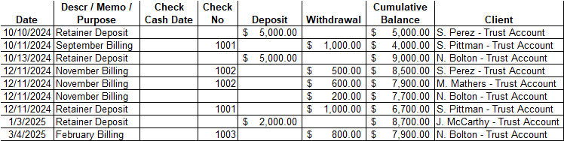
Case Study
What went wrong here?
How can we fix it?
Notes:
This is a redacted copy of an actual trust accounting check register we have reviewed.
On first glance, this may be overwhelming to look at. Where do you start? Why are there so many numbers and datapoints?
Well this is just a small piece and a great example of why things can go wrong, these reports can be difficult to interpret without taking the time to analyze them.
What went wrong?
The Check #1001 for $1000 was recorded twice.
This results in that client account having $1000 less than it should have.
It doesn’t necessarily mean the check was cut or cashed twice
How did it go wrong?
It seems the check numbers may not be consistently recorded as the $200 withdrawal does not have a check number
Review of the account was not properly performed before recording the check again.
How to fix it?
Hopefully this would be caught during the reconciliation process when you realize your records are an unreconcilable $1000 below the bank balance.
As long as you did not cut another check on that clients account, you just need to adjust one of the transactions to remove the second charge, and return the client balance back to its rightful position.
If you did cut another check, you may have to remit that money back to the trust and back to the client.
If there’s a difference in your account where there are not enough funds in your account to match your records, can you just put money back in to make it reconcile?
Putting money back in may reconcile your account to your records in total, but the real problem is someone's account was overdrawn or at the very least does not include the correct balance. You have to still go back through your books and records to find he mistake and credit those funds to the proper account to make them whole again.

Slide 24

So Remember
Maintain detailed records of all trust accounting transactions
Complete monthly reconciliations and reconcile your differences
Your clients’ trust funds are THEIR funds

Slide 25

Resources
Accounting Software
QuickBooks
Clio Trust Account Management
LawPay
RunSensible
Smokeball Bill
MN Lawyers Professional Responsibility Board (https://lprb.mncourts.gov/)
Lists of approved Banking Institutions
QuickBooks Guide to Trust Accounting
Multiple Articles about Trust Accounting
Rule 1.15 & Appendix 1
Notes:
Accounting Software like QuickBooks can help you keep all of your accounting in order and in one place. There are additional trust accounting programs built specifically for lawyer trust accounting as well:
QuickBooks
Clio Trust Account Management
LawPay
RunSensible
Smokeball Bill (Members of MSBA are eligible for a free subscription. They also put on events for MSBA. https://www.smokeball.com/bar-associations/minnesotabill
We are QB people, and cannot exactly vouch for all of these programs, but they are resources for you to explore and find whats best for you.
The MN LPRB QuickBooks guide refers to the QuickBooks desktop version. We have prepared an unofficial update to this guide for QuickBooks Online.
LPRB Articles:
Other People’s Money: Operating Lawyer Trust Accounts
EVERYTHING YOU NEED TO KNOW ABOUT TRUST ACCOUNTS – presentation and video
Conducting a trust account self-assessment
Is your trust account in order?
Safekeeping client property (including filing fees)
The basics of trust accounts
Your ethical duty of supervision
Appendix 1 has more details on the MN requirements for the maintenance of books and records.

Slide 26

Q&A
Notes:
When do I need to use an IOLTA?
When you are holding funds (particularly unearned) on behalf of a client.
When those funds are nominal / held for a short time. Otherwise, you can open an individual trust account if the interest earned exceeds the costs/taxes.
Do I always have to use an IOLTA?
When you receive funds in advance of services / expenses or funds you do not legally own, yes! It is also a good practice just in general to keep the funds of your clients separate from your own.
For client retainers. For settlement proceeds.
What if I do make an honest mistake?
It happens, as long as it is not intentional, you have the chance to correct your mistake and make any impacted client whole again. Part of the investigation (if even necessary) is to identify and resolve the issue itself.
If you maintain your accounts and complete reconciliation, when mistakes happen you can easily fix them before they compound.
How much of my own money can I keep in IOLTA?
Up to $200.
If I receive payments, some of which I have earned, how to I treat that?
You should deposit the full amount into your trust fund, then immediately transfer the earned funds to your operating account.
Is there a downside for the client to keep their funds in an account not paying interest to them?
Not really, typically trust account monies are low in value or held for a short amount of time, individually not generating much interest, if any at all.
How is a trust fund different than Escrow?
Escrow usually holds funds related to a transaction and sometimes managed by 3rd party, not just related to legal services like the trust fund. However, the IOLTA can also be used in a similar manner to escrow.
What is nominal interest generating?
Overall, generating nearly no interest, but also not enough interest to cover the costs to establish and administer the account.
How would you handle deposits by credit card?
You should deposit CC payments into your operating account then immediately transfer the unearned portion to the trust.
Why? To avoid the CC company’s/bank’s ability to reverse transactions and remove client fees. This gives a non-lawyer the power to withdraw client funds from a trust account. Also to avoid CC fees charged on the transaction so the burden to pay those is on the attorney, not the client / trust.
What if you have a flat fee arrangement but the client still pays in advance?
Your arrangement should specify that advance payments will not be held In trust and be agreed to and signed by the client beforehand. If the agreement is verbal, funds should still go into trust. MN 1.5(b).
Safekeeping client property (including filing fees), Susan M. Humiston.
Does a lawyer have to sign every check and electronic transfer memo?
Yes, lawyer signature on checks or approval for disbursements is required in Minnesota.
Can I have a debit card to withdraw trust funds or use an ATM?
No, you cannot do that.
Can I pay expenses with earned fees directly out of my IOLTA?
No, they must first be transferred to your operating account before payment can be made.

